Slide 1
Create a Trello Account
NOTE:
TRELLO ONLY WORKS WITH GOOGLE CHROME
NOT
INTERNET EXPLORER

Slide 2
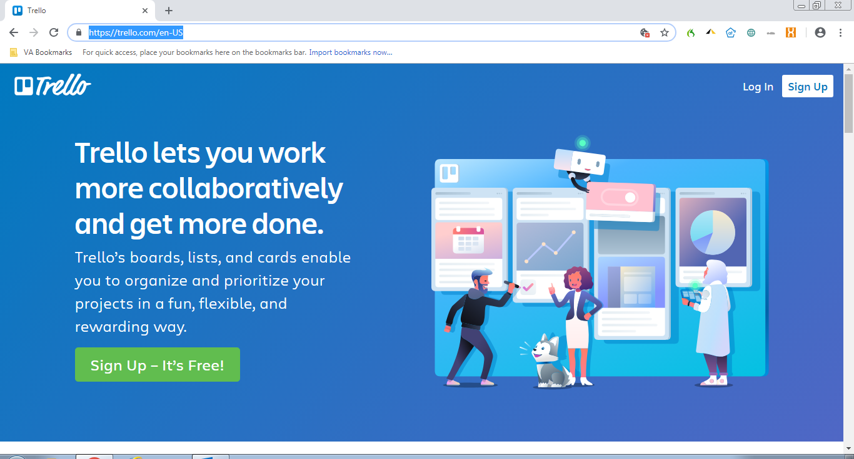
In Google chrome, go to: https://trello.com/en-US and click “Sign Up”

Slide 3
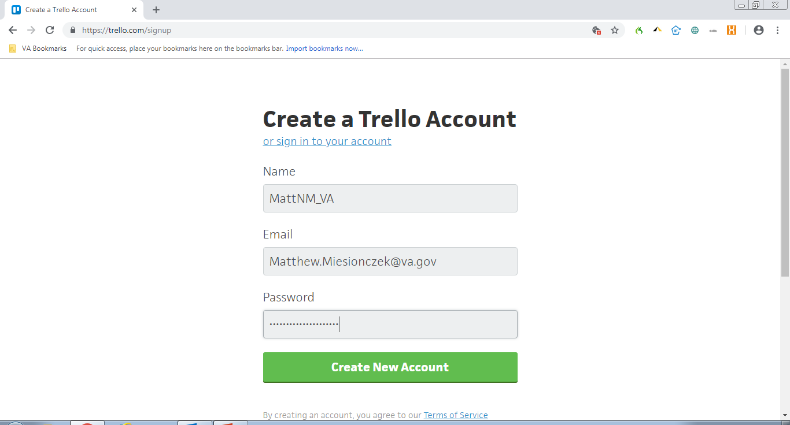
Create your username, add your VA email address, and create a password

Slide 4
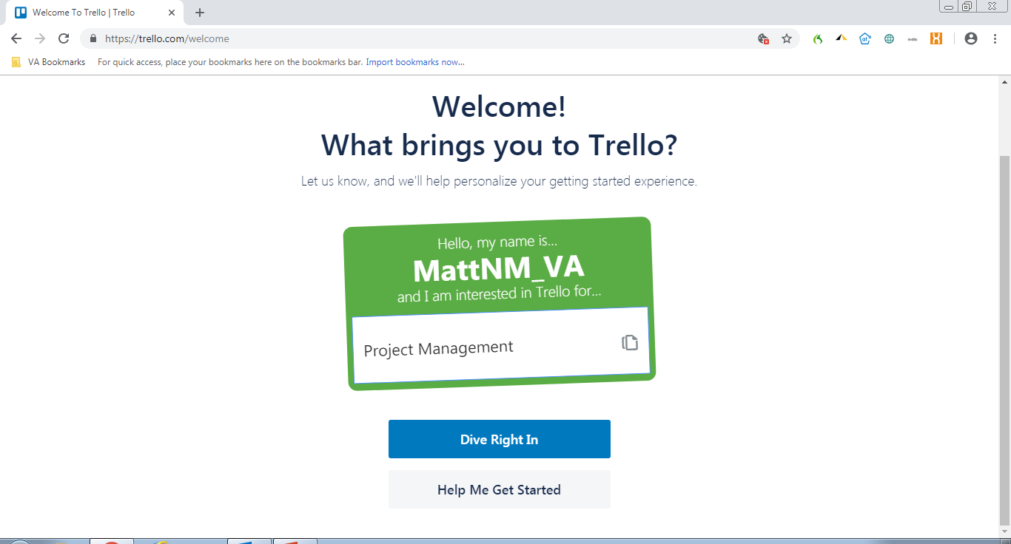
You may see a Welcome Screen

Slide 5
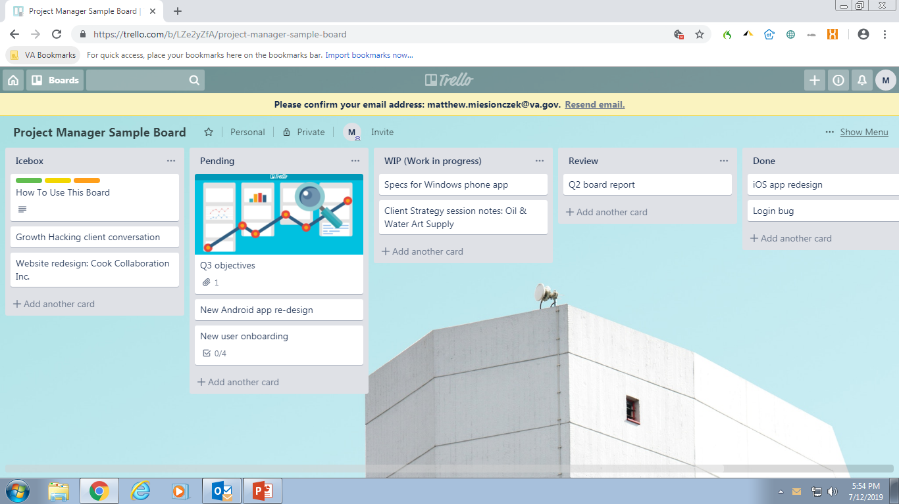
Confirm your account via email (1 of 2)

Slide 6
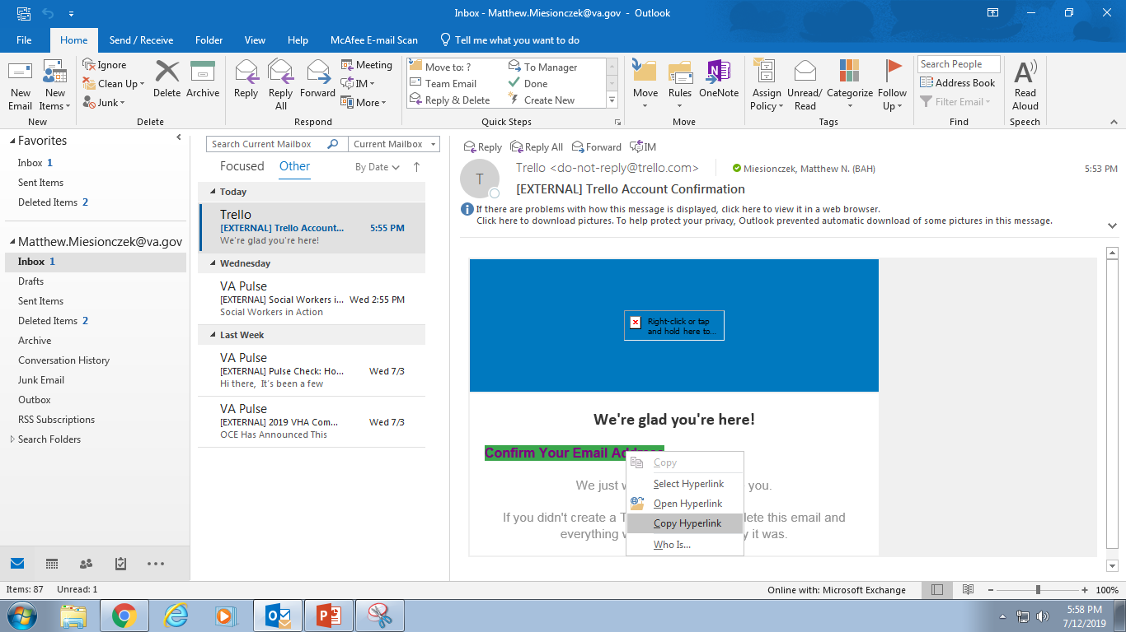
Confirm your Account (2 of 2) Right Click, COPY HYPERLINK

Slide 7
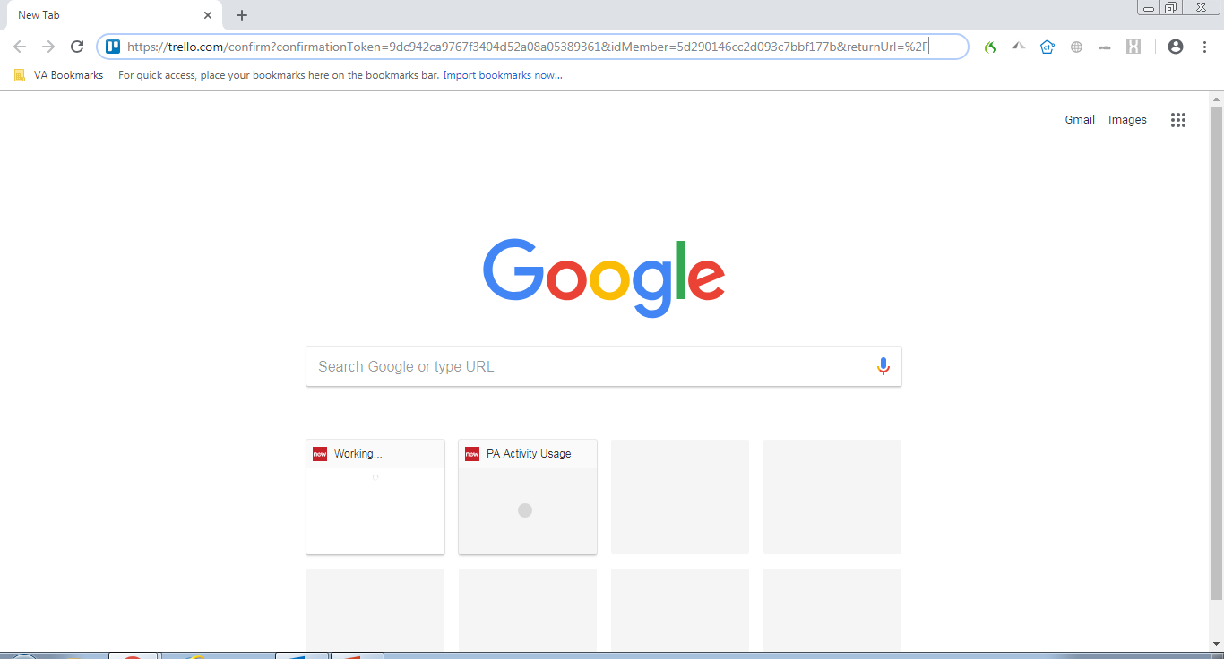
Paste the link from the email into a Chrome browser

Slide 8
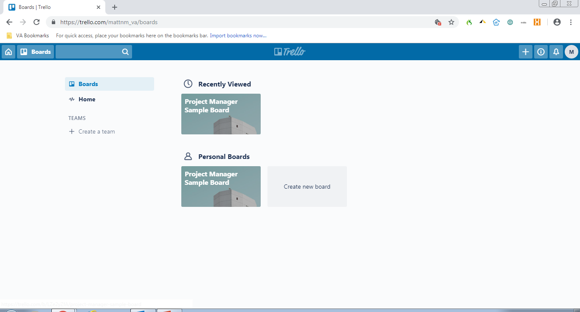
Welcome to Trello!

Slide 9
Next steps
If stuck, let me know
Miesionczek_matthew@bah.com or (917) 301-3172
Some reference notes
Trello is used by some within VEO already for basic project management
This is the FREE version hosted in the cloud.
Still TBD if VA has access to an Enterprise license for us to use (STAY TUNED), so please do NOT upload any PII, PHI, or other VA sensitive information

